Slide 1
Ames, Iowa – Housing Sale Prices
By Deepak Mongia
17-May-2020

Slide 2
Project Goals
Project goal is to identify out of the 80 independent features given for a house, which are the relevant features in deciding the Sale Price of the house
Visualize how the independent features – categorical and numerical – impact the Sale Price
Build an effective model to predict the Sale Price

Slide 3
Introduction
There are 1500 observations with the Sale Price included which have overall 80 independent features
There are 36 numerical features like: LotFrontage: Linear feet of street connected to property, LotArea: Lot size in square feet, and many others.
There are 44 categorical features like: MSZoning: Identifies the general zoning classification of the sale, Street: Type of road access to property, etc.
Data Source: https://www.kaggle.com/c/house-prices-advanced-regression-techniques/data

Slide 4
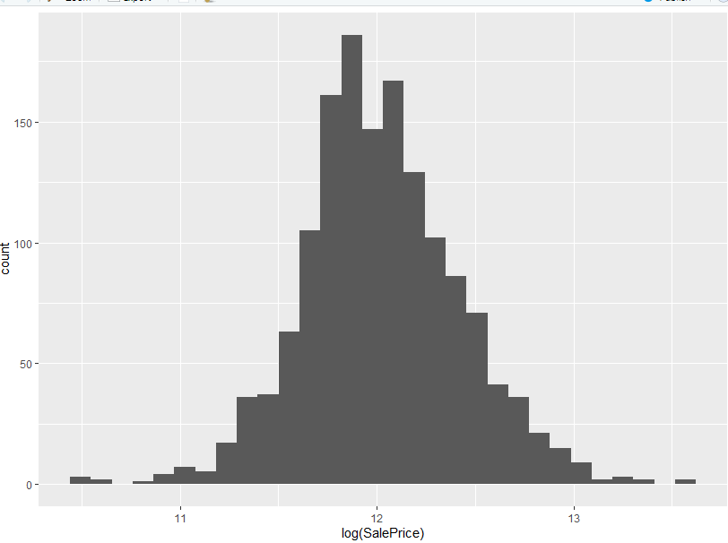
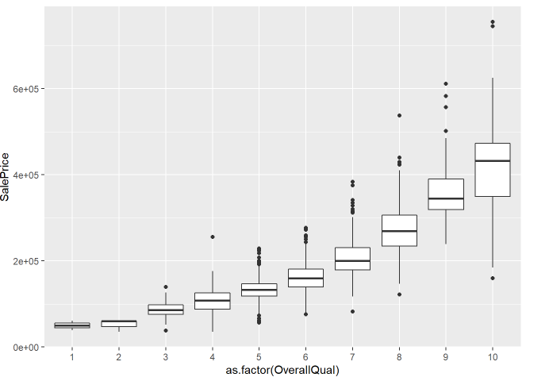
Exploratory Data Analysis
Target feature (SalePrice) distribution:
Log of SalePrice has a normal distribution
Correlation
- Sale Price vs Overall Quality

Slide 5
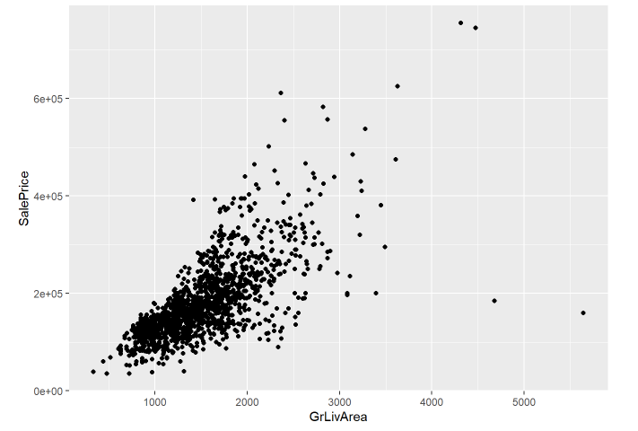
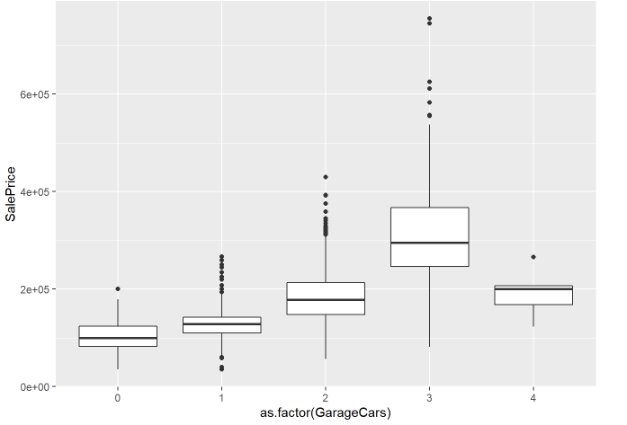
Exploratory Data Analysis – contd.
Sale Price vs Above Ground living area
- Positive linear relationship is evident
Sale Price vs Garage size – number of
cars that can come

Slide 6
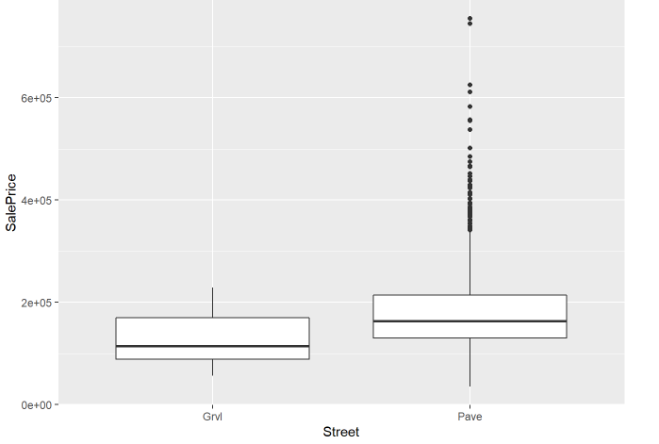
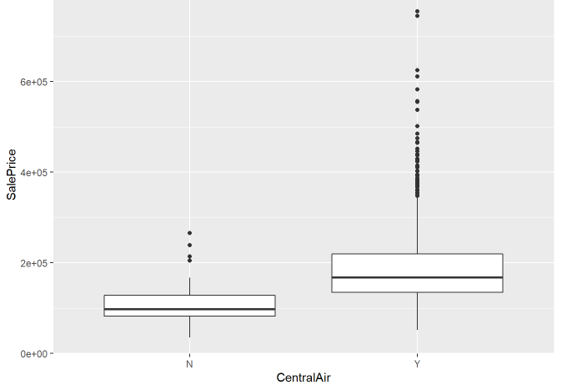
Exploratory Data Analysis – contd.
Sale Price vs Type of Street
Sale Price vs Central Air Conditioning

Slide 7
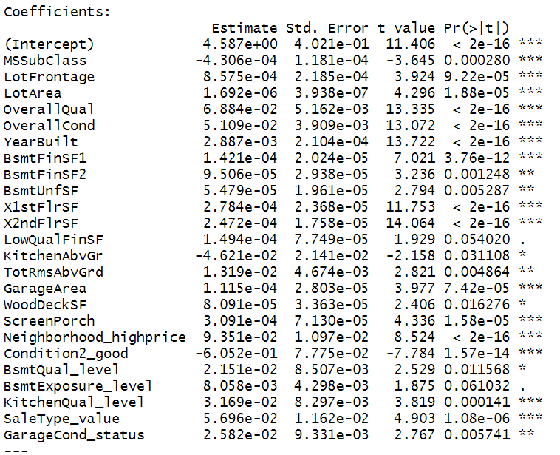
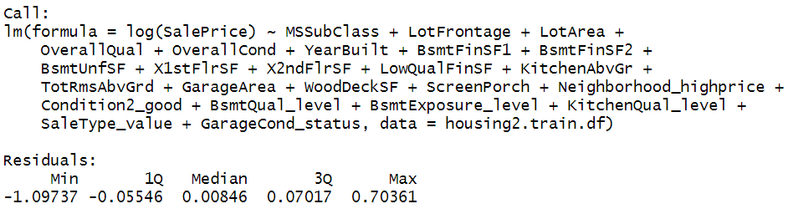

Regression Models – to predict Sale Price
The best model that was built has the following features on which SalePrice is highly dependent:

Slide 8
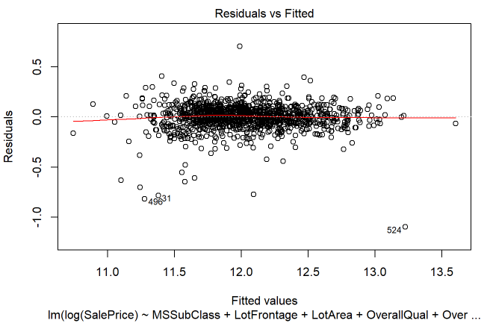
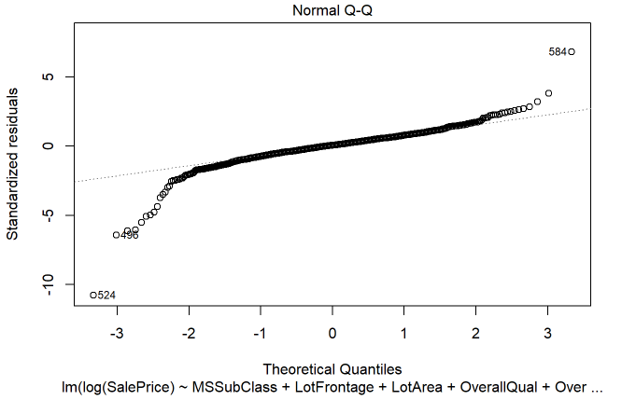
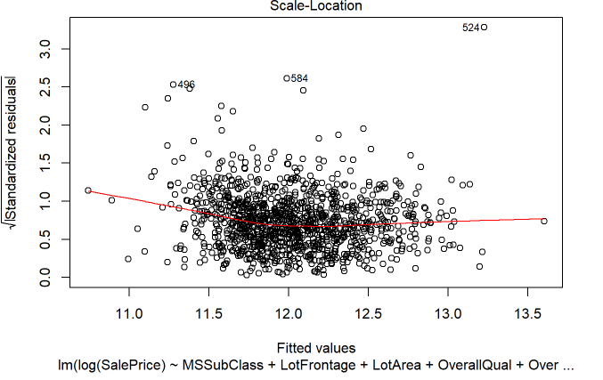
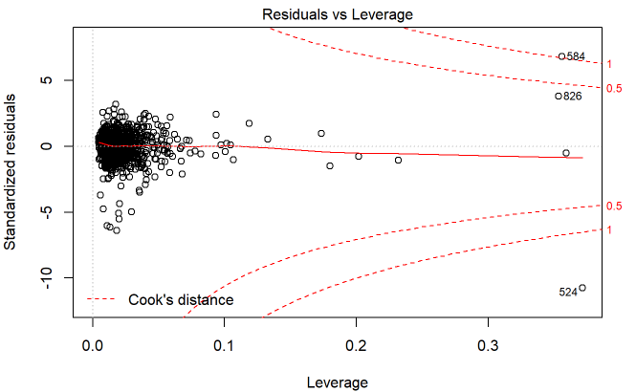
Model Plots

Slide 9
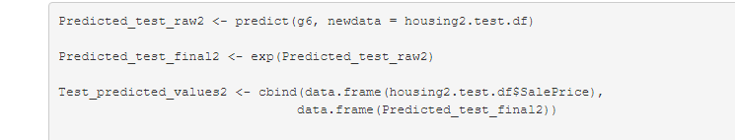
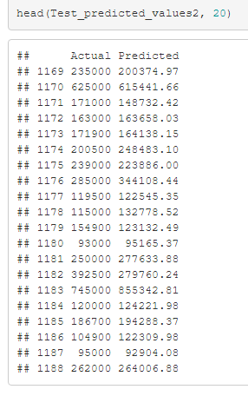
Predictions – using model
The predicted sale price looks to be very near
in values to the actual price

